Slide 1

DSLab
The Data Science Lab
Stream Processing 2
Spring 2020 – week #10

Slide 2
Stream Processing Module
Objectives
Review concepts of stream processing
Experiment with typical tools for
Data ingestion and processing
Week 09
Concepts
Experiments
Week 10
Advanced topics
Event Time vs Processing Time
Operations on streaming data (joins)
Homework
Notes:
We remind you that the objective of this module is is to introduce stream processing and do practical work with tools that are typically found in the Data Science ecosystem.
Last week, we went through general concepts and let you experiment with Spark Streaming and Kafka.
This week, we will quickly introduce two additional topics related to time constraints and operations on data streams and then move to the last homework.

Slide 3
Event Time vs Processing Time
Event Time
Processing Time
delay
Notes:
As introduced last week, there is always a lag between the time an event happens and the time it is processed in the system. This lag is due to network transit and to compute time. It is important to know the difference between the two to ensure consistency and ordering of the data.
The timeline you see here illustrates the difference between even time and processing time.

Slide 4
Event Time vs Processing Time
1
4
5
2
3
6
Event Time
1, 2, 3, 4, 5, 6, …
1
5
2
6
4
3
Processing Time
2, 3, 1, 6, 5 , 4, …
Notes:
On this time-line, you will notice two things:
Data elements arrive with variable delays. For example, data element 4 arrives which a larger delay than data element 1
Order is not maintained as you see in the resulting sequence

Slide 5
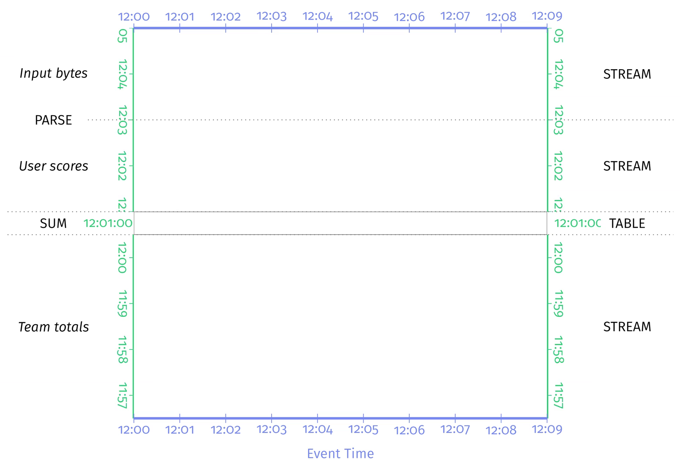
Event Time vs Processing Time
Credits: Tyler Akidau (et al.), Streaming Systems, O’Reilly Media, 2018.
Notes:
You can also see this on this animation. The effect of out of order and delayed data has a direct impact on aggregations like sums in this example. You see that the result of the SUM varies until all data is received. Remember that in the context of stream processing, we accept to have results that are good enough. The art is to find the right compromise between quality of the results and processing delays.

Slide 6
Event Time vs Processing Time
Credits: Tyler Akidau (et al.), Streaming Systems, O’Reilly Media, 2018.
Notes:
From another perspective, you see how reality looks like. We are far from the ideal case illustrated with the straight line.

Slide 7
Event Time vs Processing Time
Credits: Tyler Akidau (et al.), Streaming Systems, O’Reilly Media, 2018.
Notes:
To deal with this difference between Event Time and Processing Time, the concept of Watermarks is introduced. Watermarks are simply time thresholds that dictate how long we wait for events before declaring that they are late. Any events beyond the watermark are simply discarded.

Slide 8
Watermarking in Spark Streaming
Count on a sliding window of 10 minutes long with 5 minutes
sliding interval with 10 minutes watermarking (lateness).
from pyspark.sql.functions import *
windowedAvgDF = \ eventsDF \ .withWatermark("eventTime", "10 minutes") \ .groupBy(window("eventTime", "10 minutes", "5 minutes")) \ .count()
Notes:
On this slide, you see how watermarks are declared in Spark. You can refer to the official documentation for more examples.

Slide 9
Operations
How it works
DStream: continuous stream of data
Created from inputs (e.g. Kafka) or derived from other DStreams
Supports transformations like RDDs
(map, count, join, etc)
Image credits: https://spark.apache.org/docs/latest/streaming-programming-guide.html
Notes:
As you have seen last week, Spark Streaming relies on DStreams which can be seen as a continuous series of RDDs and support many operations already supported by RDDs.

Slide 10
Operations: Joins
A
B
Joins
Combining different sets of data (tables) to get a set of results based on some criteria
Streaming Streaming
Stream-Static joins
Stream-Stream joins
Notes:
One important operation found in data management systems is joins. Joins allows you to combine different sets of data commonly presented as tables to a get a set of results based on some criteria.
On the right, you see a representation of a join between two sets of data A and B. There are different types of joins. An inner join for example, will contain the elements present in both sets A and B.
Spark streaming supports both Stream-Static joins and Stream-Stream joins.
Generating join results in streaming context is challenging as at any point of time, the view of the dataset is incomplete, and data can be late or out-of-order. Depending on the application and data, you may need to use watermarks.
You will see this in the following example.

Slide 11
Operations: Joins
Stream-Stream Joins:
2 streams over a common key
Example: Ad monetization (*)
(*) Databricks Engineering Blog, Introducing Stream-Stream Joins in Apache Spark 2.3 by Tathagata Das and Joseph Torres , https://bit.ly/2I58Ve7
Notes:
This example is taken from the DataBricks Engineering Blog. We highly recommend you to read it as it shows you how to make a join between two streams in a real-life use-case.
The use-case the authors have chosen is the one of Ad monetization, which is key to advertisement business.
They authors needed to join the following:
On the one hand: Ad Impression (which is when an advertisement was displayed to a user)
On the other hand: Ad clicks (which is when the displayed Ad was clicked by the user)
The figure you see shows a high level representation of the problem. Although, this is conceptually simple and is a very basic operation when applied on static historical data, it becomes challenging when applied on streaming data. Remember that we want to have results short time after the events happen.

Slide 12
Operations: Joins
Streaming Constraints (*)
Handling of late/out of order data
Boundaries
Solution
Use watermarks for delays / out of order impressionTime and clickTime
Set time range boundaries for the join conditions on event-time windows
(*) Databricks Engineering Blog, Introducing Stream-Stream Joins in Apache Spark 2.3 by Tathagata Das and Joseph Torres , https://bit.ly/2I58Ve7
Notes:
As streams are running continuously, we are facing two constraints:
On the one hand, data can be late or out of order and needs to be buffered
On the other hand, if we keep buffering the data without setting boundaries, we will never be able to execute the joins
The solution to handle these constraints is
Use watermarks for delays / out of order impressionTime and clickTime
Set time range boundaries for the join conditions on event-time windows

Slide 13
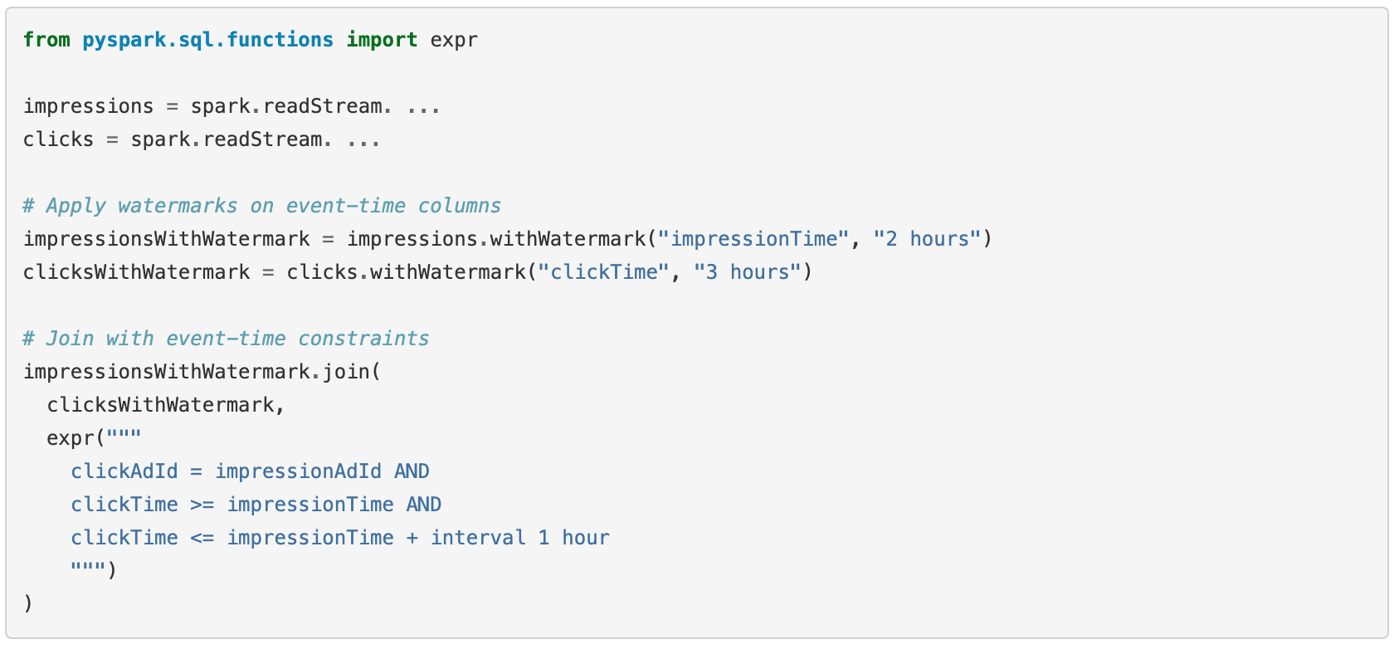
Operations: Joins
Notes:
In the example, the authors assumed that the impressions and the corresponding clicks can be late/out-of-order in event-time by at most 2 and 3 hours, respectively.
They also assumed that a click can occur with a time range of 0 seconds to 1 hour after the corresponding impression.
When translating this into Spark Streaming this is how it will look like.
We hope that this example helped you understanding the time constraints in streaming data processing and how you can deal with them. You will have the chance to apply this with the final homework of this course.

Slide 14
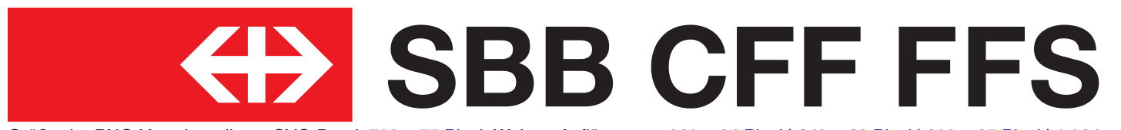
Homework
Historical data (Static)
Live data (streaming)
NS trains (Netherlands)
Notes:
In this homework, you will deal with real-time data that come from from trains.
Up to now, we used data from the Swiss railway system but only for historical data. We could not get access to good quality real-time data from the swiss railway system, what is available from SBB is with a limited time resolution and won’t be usable for the homework.
We had therefore relied on another data stream from the netherlands. As you will see in the homework, we relayed the live stream onto our Kafka cluster and you can directly access the live data from Spark.
The homework is well documented and will help you concretely apply the important aspects of stream processing without difficulty.
Good luck with the homework. We are available together with the other instructors to answer your questions through the usual channels today and the following weeks.

